Slide 1
The Civil Rights Movement
Harlem Renaissance
Segregation
School Desegregation
The Montgomery Bus Boycott
Sit-Ins
Freedom Riders
Desegregating Southern Universities
The March on Washington
Voter Registration
The End of the Movement

Slide 2
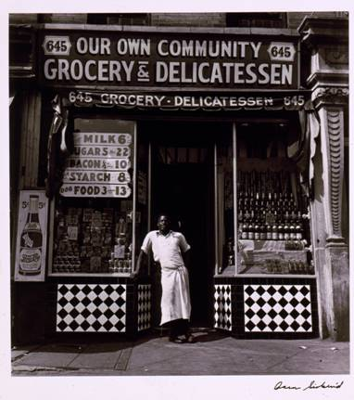
Harlem Renaissance
The Harlem Renaissance was an African American cultural movement of the 1920s and early 1930s centered around the Harlem neighborhood of New York City.
[Grocery store, Harlem, 1940]
Library of Congress Prints and Photographs Division Washington, D.C.; LC-USZC4-4737

Slide 3
Harlem Renaissance
The Harlem Renaissance marked the first time that mainstream publishers and critics took African American literature seriously and African American arts attracted significant attention from the nation at large.
Instead of more direct political means, African American artists and writers used culture to work for the goals of civil rights and equality.
African American writers intended to express themselves freely, no matter what the public thought.

Slide 4
Harlem Renaissance
Several factors laid the groundwork for the movement.
During a phenomenon known as the Great Migration, hundreds of thousands of African Americans moved from the economically depressed rural South to the industrial cities of the North, taking advantage of employment opportunities created by World War I.

Slide 5
Harlem Renaissance
Increased education and employment opportunities following World War I led to the development of an African American middle class.
As more and more educated and socially conscious African Americans settled in New York’s neighborhood of Harlem, it developed into the political and cultural center of black America.

Slide 6
Harlem Renaissance
African American literature and arts surged in the early 1900s.
Jazz and blues music moved with the African American populations from the South and Midwest into the bars and cabarets of Harlem.
This generation of African Americans artists, writers, and performers refused to let the reality of racism and discrimination in the United States keep them from pursuing their goals.

Slide 7
Harlem Renaissance
In the autumn of 1926, a group of young African American writers produced Fire!, a literary magazine.
With Fire! a new generation of young writers and artists, including Langston Hughes, Wallace Thurman, and Zora Neale Hurston, took ownership of the literary Renaissance.

Slide 8
Harlem Renaissance
No common literary style or political ideology defined the Harlem Renaissance. What united the participants was the sense of taking part in a common endeavor and their commitment to giving artistic expression to the African American experience.
Some common themes did exist, however. An interest in the roots of the twentieth- century African American experience in Africa and the American South was one such theme.

Slide 9
Harlem Renaissance
There was a strong sense of racial pride and a desire for social and political equality among the participants.
The most characteristic aspect of the Harlem Renaissance was the diversity of its expression.
From the mid-1920s through the mid-1930s, about 16 African American writers published over 50 volumes of poetry and fiction, while dozens of other African American artists made their mark in painting, music, and theater.

Slide 10
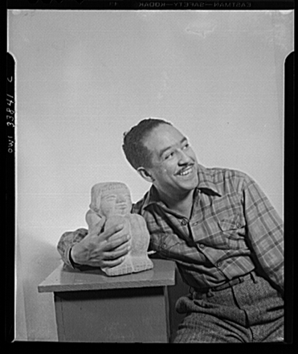
Harlem Renaissance
The diverse literary expression of the Harlem Renaissance was demonstrated through Langston Hughes’s weaving of the rhythms of African American music into his poems of ghetto life, as in The Weary Blues (1926).
Langston Hughes
Library of Congress, Prints & Photographs Division, FSA/OWI Collection, [reproduction number, e.g., LC-USF34-9058-C]

Slide 11
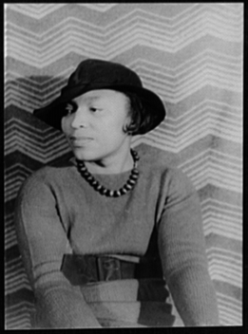
Harlem Renaissance
Diversity was also demonstrated through Zora Neale Hurston’s novels such as, Their Eyes Were Watching God (1937). Hurston used life of the rural South to create a study of race and gender in which a woman finds her true identity.
[Portrait of Zora Neale Hurston]
Library of Congress, Prints & Photographs Division, Carl Van Vechten Collection, [reproduction number, e.g., LC-USZ62-54231]

Slide 12
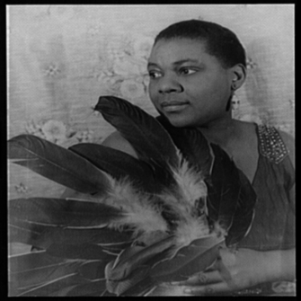
Harlem Renaissance
Diversity and experimentation also flourished in the performing arts and were reflected in blues by such people as Bessie Smith and in jazz by such people as Duke Ellington.
[Portrait of Bessie Smith holding feathers]
Library of Congress, Prints & Photographs Division, Carl Van Vechten Collection, [reproduction number, e.g., LC-USZ62-54231]

Slide 13
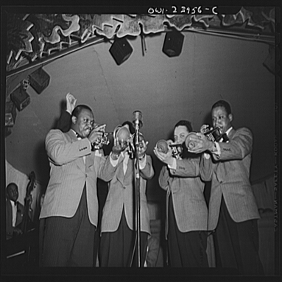
Harlem Renaissance
Jazz styles ranged from the combination of blues and ragtime by pianist Jelly Role Morton to the instrumentation of bandleader Louis Armstrong and the orchestration of composer Duke Ellington.
New York, New York. Duke Ellington's trumpet section
Library of Congress, Prints & Photographs Division, FSA/OWI Collection, [reproduction number, e.g., LC-USF34-9058-C]

Slide 14
Harlem Renaissance
The Harlem Renaissance pushed open the door for many African American authors to mainstream white periodicals and publishing houses.
Harlem’s cabarets attracted both Harlem residents and white New Yorkers seeking out Harlem nightlife.
Harlem’s famous Cotton Club carried this to an extreme, providing African American entertainment for exclusively white audiences.

Slide 15
Harlem Renaissance
A number of factors contributed to the decline of the Harlem Renaissance in the mid-1930s.
During the Great Depression of the 1930s, organizations such as the NAACP and the National Urban League, which had actively promoted the Renaissance in the 1920s, shifted their focus to economic and social issues.

Slide 16
Harlem Renaissance
Many influential African American writers and literary promoters, including Langston Hughes, James Weldon Johnson, and W.E.B. Du Bois, left New York City in the early 1930s.
The final blow to the Renaissance occurred when a riot broke out in Harlem in 1935. The riot was set off, in part, by the growing economic hardship brought on by the Depression and by mounting tension between the African American community and the white shop owners in Harlem.

Slide 17
Harlem Renaissance
In spite of these problems, the Renaissance did not end overnight.
Almost one-third of the books published during the Renaissance appeared after 1929.
The Harlem Renaissance permanently altered the dynamics of African American art and literature in the United States.

Slide 18
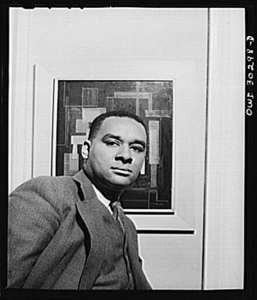
Harlem Renaissance
The existence of the large amount of literature from the Renaissance inspired writers such as Ralph Ellison and Richard Wright to pursue literary careers in the late 1930s and 1940s.
New York, New York. Portrait of Richard Wright, poet
Library of Congress, Prints & Photographs Division, FSA/OWI Collection, [reproduction number, e.g., LC-USF34-9058-C]

Slide 19
Harlem Renaissance
The writers that followed the Harlem Renaissance found that American publishers and the American public were more open to African American literature than they had been at the beginning of the twentieth century.
The outpouring of African American literature in the 1980s and 1990s by such writers as Alice Walker, Toni Morrison, and Spike Lee had its roots in the writing of the Harlem Renaissance.

Slide 20
Segregation
The civil rights movement was a political, legal, and social struggle to gain full citizenship rights for African Americans.
The civil rights movement was first and foremost a challenge to segregation, the system of laws and customs separating African Americans and whites.
During the movement, individuals and civil rights organizations challenged segregation and discrimination with a variety of activities, including protest marches, boycotts, and refusal to abide by segregation laws.

Slide 21
Segregation
Segregation was an attempt by many white Southerners to separate the races in every aspect of daily life.
Segregation was often called the Jim Crow system, after a minstrel show character from the 1830s who was an African American slave who embodied negative stereotypes of African Americans.

Slide 22
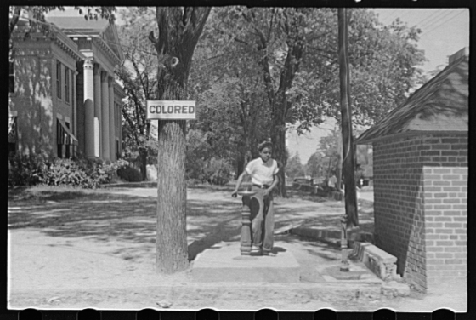
Segregation
Segregation became common in Southern states following the end of Reconstruction in 1877. These states began to pass local and state laws that specified certain places “For Whites Only” and others for “Colored.”
Drinking fountain on county courthouse lawn, Halifax, North Carolina;
Library of Congress, Prints & Photographs Division, FSA/OWI Collection, [reproduction number, e.g., LC-USF34-9058-C]

Slide 23
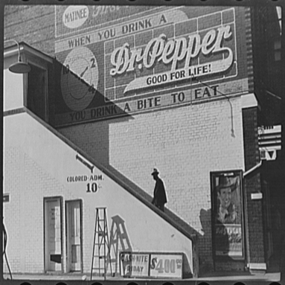
Segregation
African Americans had separate schools, transportation, restaurants, and parks, many of which were poorly funded and inferior to those of whites.
Over the next 75 years, Jim Crow signs to separate the races went up in every possible place.
Negro going in colored entrance of movie house on Saturday afternoon, Belzoni, Mississippi Delta, Mississippi
Library of Congress, Prints & Photographs Division, FSA/OWI Collection, [reproduction number, e.g., LC-USF34-9058-C]

Slide 24
Segregation
The system of segregation also included the denial of voting rights, known as disenfranchisement.
Between 1890 and 1910, all Southern states passed laws imposing requirements for voting. These were used to prevent African Americans from voting, in spite of the Fifteenth Amendment to the Constitution of the United States, which had been designed to protect African American voting rights.

Slide 25
Segregation
The voting requirements included the ability to read and write, which disqualified many African Americans who had not had access to education; property ownership, which excluded most African Americans, and paying a poll tax, which prevented most Southern African Americans from voting because they could not afford it.

Slide 26
Segregation
Conditions for African Americans in the Northern states were somewhat better, though up to 1910 only ten percent of African Americans lived in the North.
Segregated facilities were not as common in the North, but African Americans were usually denied entrance to the best hotels and restaurants.
African Americans were usually free to vote in the North.

Slide 27
Segregation
Perhaps the most difficult part of Northern life was the economic discrimination against African Americans. They had to compete with large numbers of recent European immigrants for job opportunities, and they almost always lost because of their race.

Slide 28
Segregation
In the late 1800s, African Americans sued to stop separate seating in railroad cars, states’ disfranchisement of voters, and denial of access to schools and restaurants.
One of the cases against segregated rail travel was Plessy v. Ferguson (1896), in which the Supreme Court of the United States ruled that “separate but equal” accommodations were constitutional.

Slide 29
Segregation
In order to protest segregation, African Americans created national organizations.
The National Afro-American League was formed in 1890; W.E.B. Du Bois helped create the Niagara Movement in 1905 and the National Association for the Advancement of Colored People (NAACP) in 1909.

Slide 30
Segregation
In 1910, the National Urban League was created to help African Americans make the transition to urban, industrial life.
In 1942, the Congress of Racial Equality (CORE) was founded to challenge segregation in public accommodations in the North.

Slide 31
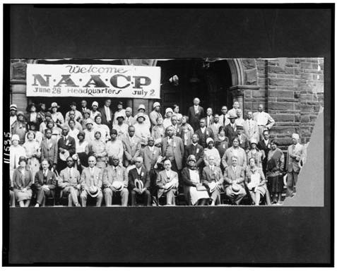
Segregation
The NAACP became one of the most important African American organizations of the twentieth century. It relied mainly on legal strategies that challenged segregation and discrimination in the courts.
20th Annual session of the N.A.A.C.P., 6-26-29, Cleveland, Ohio
Library of Congress Prints and Photographs Division Washington, D.C.; LC-USZ62-111535

Slide 32
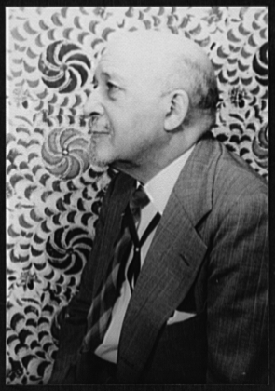
Segregation
Historian and sociologist W.E.B. Du Bois was a founder and leader of the NAACP. Starting in 1910, he made powerful arguments protesting segregation as editor of the NAACP magazine The Crisis.
[Portrait of Dr. W.E.B. Du Bois]
Library of Congress, Prints & Photographs Division, Carl Van Vechten Collection, [reproduction number, e.g., LC-USZ62-54231]

Slide 33
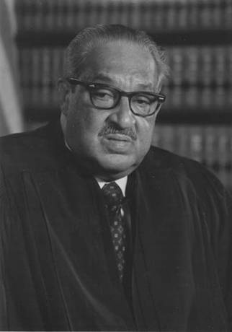
School Desegregation
After World War II, the NAACP’s campaign for civil rights continued to proceed.
Led by Thurgood Marshall, the NAACP Legal Defense Fund challenged and overturned many forms of discrimination.
Thurgood Marshall

Slide 34
School Desegregation
The main focus of the NAACP turned to equal educational opportunities.
Marshall and the Defense Fund worked with Southern plaintiffs to challenge the Plessy decision, arguing that separate was inherently unequal.
The Supreme Court of the United States heard arguments on five cases that challenged elementary and secondary school segregation.

Slide 35
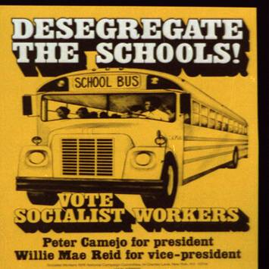
School Desegregation
In May 1954, the Court issued its landmark ruling in Brown v. Board of Education of Topeka, stating racially segregated education was unconstitutional and overturning the Plessy decision.
White Southerners were shocked by the Brown decision.
Desegregate the schools! Vote Socialist Workers : Peter Camejo for president, Willie Mae Reid for vice-president.
Library of Congress Prints and Photographs Division Washington, D.C.; LC-USZ62-101452

Slide 36
School Desegregation
By 1955, white opposition in the South had grown into massive resistance, using a strategy to persuade all whites to resist compliance with the desegregation orders.
Tactics included firing school employees who showed willingness to seek integration, closing public schools rather than desegregating, and boycotting all public education that was integrated.

Slide 37
School Desegregation
Virtually no schools in the South segregated their schools in the first years following the Brown decision.
In Virginia, one county actually closed its public schools.
In 1957, Governor Orval Faubus defied a federal court order to admit nine African American students to Central High School in Little Rock, Arkansas.
President Dwight Eisenhower sent federal troops to enforce desegregation.

Slide 38
School Desegregation
The event was covered by the national media, and the fate of the nine students attempting to integrate the school gripped the nation.
Not all school desegregation was as dramatic as Little Rock schools gradually desegregated.
Often, schools were desegregated only in theory because racially segregated neighborhoods led to segregated schools.
To overcome the problem, some school districts began busing students to schools outside their neighborhoods in the 1970s.

Slide 39
School Desegregation
As desegregation continued, the membership of the Ku Klux Klan (KKK) grew.
The KKK used violence or threats against anyone who was suspected of favoring desegregation or African American civil rights.
Ku Klux Klan terror, including intimidation and murder, was widespread in the South during the 1950s and 1960s, though Klan activities were not always reported in the media.

Slide 40
The Montgomery Bus Boycott
Despite threats and violence, the civil rights movement quickly moved beyond school desegregation to challenge segregation in other areas.
In December 1955, Rosa Parks, a member of the Montgomery, Alabama, branch of the NAACP, was told to give up her seat on a city bus to a white person.

Slide 41
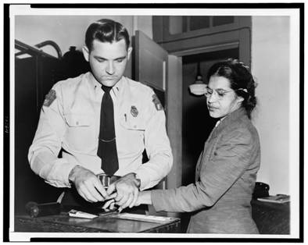
The Montgomery Bus Boycott
When Parks refused to move, she was arrested.
The local NAACP, led by Edgar D. Nixon, recognized that the arrest of Parks might rally local African Americans to protest segregated buses.
Woman fingerprinted. Mrs. Rosa Parks, Negro seamstress, whose refusal to move to the back of a bus touched off the bus boycott in Montgomery, Ala.
Library of Congress Prints and Photographs Division Washington, D.C.; LC-USZ62-109643

Slide 42
The Montgomery Bus Boycott
Montgomery’s African American community had long been angry about their mistreatment on city buses where white drivers were rude and abusive.
The community had previously considered a boycott of the buses and overnight one was organized.
The bus boycott was an immediate success, with almost unanimous support from the African Americans in Montgomery.

Slide 43
The Montgomery Bus Boycott
The boycott lasted for more than a year, expressing to the nation the determination of African Americans in the South to end segregation.
In November 1956, a federal court ordered Montgomery’s buses desegregated and the boycott ended in victory.

Slide 44
The Montgomery Bus Boycott
A Baptist minister named Martin Luther King, Jr., was president of the Montgomery Improvement Association, the organization that directed the boycott.
His involvement in the protest made him a national figure. Through his eloquent appeals to Christian brotherhood and American idealism he attracted people both inside and outside the South.

Slide 45
The Montgomery Bus Boycott
King became the president of the Southern Christian Leadership Conference (SCLC) when it was founded in 1957.
The SCLC complemented the NAACP’s legal strategy by encouraging the use of nonviolent, direct action to protest segregation. These activities included marches, demonstrations, and boycotts.
The harsh white response to African Americans’ direct action eventually forced the federal government to confront the issue of racism in the South.

Slide 46
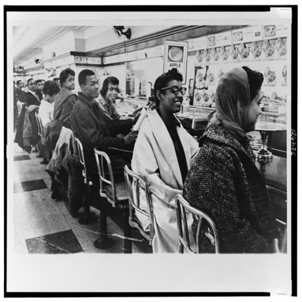
Sit-Ins
On February 1, 1960, four African American college students from North Carolina A&T University began protesting racial segregation in restaurants by sitting at “White Only” lunch counters and waiting to be served.
Sit-ins in a Nashville store
Library of Congress Prints and Photographs Division Washington, D.C.; LC-USZ62-126236

Slide 47
Sit-Ins
This was not a new form of protest, but the response to the sit-ins spread throughout North Carolina, and within weeks sit-ins were taking place in cities across the South.
Many restaurants were desegregated in response to the sit-ins.
This form of protest demonstrated clearly to African Americans and whites alike that young African Americans were determined to reject segregation.

Slide 48
Sit-Ins
In April 1960, the Student Nonviolent Coordinating Committee (SNCC) was founded in Raleigh, North Carolina, to help organize and direct the student sit-in movement.
King encouraged SNCC’s creation, but the most important early advisor to the students was Ella Baker, who worked for both the NAACP and SCLC.

Slide 49
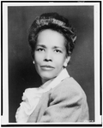
Sit-Ins
Baker believed that SNCC civil rights activities should be based in individual African American communities.
SNCC adopted Baker’s approach and focused on making changes in local communities, rather than striving for national change.
[Ella Baker, head-and-shoulders portrait, facing slightly left]
Library of Congress Prints and Photographs Division Washington, D.C.; LC-USZ62-110575

Slide 50
Freedom Riders
After the sit-in movement, some SNCC members participated in the 1961 Freedom Rides organized by CORE.
The Freedom Riders, both African American and white, traveled around the South in buses to test the effectiveness of a 1960 U.S. Supreme Court decision declaring segregation illegal in bus stations open to interstate travel.

Slide 51
Freedom Riders
The Freedom Rides began in Washington, D.C. Except for some violence in Rock Hill, South Carolina, the trip was peaceful until the buses reached Alabama, where violence erupted.
In Anniston, Alabama, one bus was burned and some riders were beaten.
In Birmingham, a mob attacked the riders when they got off the bus.
The riders suffered even more severe beatings in Montgomery.

Slide 52
Freedom Riders
The violence brought national attention to the Freedom Riders and fierce condemnation of Alabama officials for allowing the brutality to occur.
The administration of President John F. Kennedy stepped in to protect the Freedom Riders when it was clear that Alabama officials would not guarantee their safe travel.

Slide 53
Freedom Riders
The riders continued on to Jackson, Mississippi, where they were arrested and imprisoned at the state penitentiary, ending the protest.
The Freedom Rides did result in the desegregation of some bus stations, but more importantly they caught the attention of the American public.

Slide 54
Desegregating Southern Universities
In 1962, James Meredith—an African American—applied for admission to the University of Mississippi.
The university attempted to block Meredith’s admission, and he filed suit.
After working through the state courts, Meredith was successful when a federal court ordered the university to desegregate and accept Meredith as a student.

Slide 55
Desegregating Southern Universities
The Governor of Mississippi, Ross Barnett, defied the court order and tried to prevent Meredith from enrolling.
In response, the administration of President Kennedy intervened to uphold the court order. Kennedy sent federal troops to protect Meredith when he went to enroll.
During his first night on campus, a riot broke out when whites began to harass the federal marshals.
In the end, two people were killed and several hundred were wounded.

Slide 56
Desegregating Southern Universities
In 1963, the governor of Alabama, George C. Wallace, threatened a similar stand, trying to block the desegregation of the University of Alabama. The Kennedy administration responded with the full power of the federal government, including the U.S. Army.
The confrontations with Barnett and Wallace pushed President Kennedy into a full commitment to end segregation.
In June 1963, Kennedy proposed civil rights legislation.

Slide 57
The March on Washington
National civil rights leaders decided to keep pressure on both the Kennedy administration and Congress to pass the civil rights legislation. The leaders planned a March on Washington to take place in August 1963.
This idea was a revival of A. Phillip Randolph’s planned 1941 march, which had resulted in a commitment to fair employment during World War II.

Slide 58
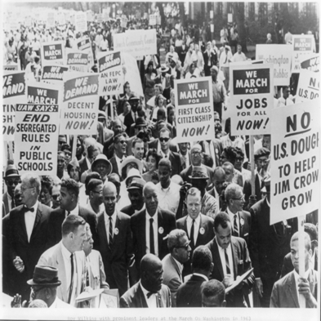
The March on Washington
Randolph was present at the march in 1963, along with the leaders of the NAACP, CORE, SCLC, the Urban League, and SNCC.
Roy Wilkins with a few of the 250,000 participants on the Mall heading for the Lincoln Memorial in the NAACP march on Washington on August 28, 1963]
Library of Congress Prints and Photographs Division Washington, D.C.; LC-USZ62-77160

Slide 59
The March on Washington
Martin Luther King, Jr., delivered a moving address to an audience of more than 200,000 people.
His “I Have a Dream” speech—delivered in front of the giant statue of Abraham Lincoln—became famous for the way in which it expressed the ideals of the civil rights movement.
After President Kennedy was assassinated in November 1963, the new president, Lyndon Johnson, strongly urged the passage of the civil rights legislation as a tribute to Kennedy’s memory.

Slide 60
The March on Washington
Over fierce opposition from Southern legislators, Johnson pushed the Civil Rights Act of 1964 through Congress.
It prohibited segregation in public accommodations and discrimination in education and employment. It also gave the executive branch of government the power to enforce the act’s provisions.

Slide 61
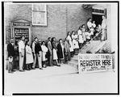
Voter Registration
Starting in 1961, SNCC and CORE organized voter registration campaigns in the predominantly African American counties of Mississippi, Alabama, and Georgia.
[NAACP photograph showing people waiting in line for voter registration, at Antioch Baptist Church]
Library of Congress Prints and Photographs Division Washington, D.C.; LC-USZ62-122260

Slide 62
Voter Registration
SNCC concentrated on voter registration because leaders believed that voting was a way to empower African Americans so that they could change racist policies in the South.
SNCC members worked to teach African Americans necessary skills, such as reading, writing, and the correct answers to the voter registration application.

Slide 63
Voter Registration
These activities caused violent reactions from Mississippi’s white supremacists.
In June 1963, Medgar Evers, the NAACP Mississippi field secretary, was shot and killed in front of his home.
In 1964, SNCC workers organized the Mississippi Summer Project to register African Americans to vote in the state, wanting to focus national attention on the state’s racism.

Slide 64
Voter Registration
SNCC recruited Northern college students, teachers, artists, and clergy to work on the project. They believed the participation of these people would make the country concerned about discrimination and violence in Mississippi.
The project did receive national attention, especially after three participants—two of whom were white—disappeared in June and were later found murdered and buried near Philadelphia, Mississippi.

Slide 65
Voter Registration
By the end of the summer, the project had helped thousands of African Americans attempt to register, and about one thousand actually became registered voters.
In early 1965, SCLC members employed a direct-action technique in a voting-rights protest initiated by SNCC in Selma, Alabama.
When protests at the local courthouse were unsuccessful, protesters began to march to Montgomery, the state capital.

Slide 66
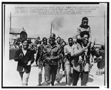
Voter Registration
As marchers were leaving Selma, mounted police beat and tear-gassed them.
Televised scenes of the violence, called Bloody Sunday, shocked many Americans, and the resulting outrage led to a commitment to continue the Selma March.
A small band of Negro teenagers march singing and clapping their hands for a short distance, Selma, Alabama.
Library of Congress Prints and Photographs Division Washington, D.C.; LC-USZ62-127739

Slide 67
Voter Registration
King and SCLC members led hundreds of people on a five-day, fifty-mile march to Montgomery.
The Selma March drummed up broad national support for a law to protect Southern African Americans’ right to vote.
President Johnson persuaded Congress to pass the Voting Rights Act of 1965, which suspended the use of literacy and other voter qualification tests in voter registration.

Slide 68
Voter Registration
Over the next three years, almost one million more African Americans in the South registered to vote.
By 1968, African American voters had having a significant impact on Southern politics.
During the 1970s, African Americans were seeking and winning public offices in majority African American electoral districts.

Slide 69
The End of the Movement
For many people the civil rights movement ended with the death of Martin Luther King, Jr. in 1968.
Others believe it was over after the Selma March, because there have not been any significant changes since then.
Still others argue the movement continues today because the goal of full equality has not yet been achieved.

