Slide 1
Leaders Of The Civil Rights Movement
Ben C. Horace Greeley High School Ms. Pojer
American History, AP
Notes:
Big Picture:
Academy Of Achievement Photo Credit
<http://www.achievement.org/autodoc/photocredit/achievers/wil1-017>
Left Margin (top to bottom)
Wikipedia image at Answers.com
<http://www.answers.com/topic/-122>
2. Wikipedia image at Answers.com
<http://www.answers.com/martin%20luther%20king>
3. Malcolm.jpg at answers.com
<http://www.answers.com/topic/malcom011-jpg>
4. Wikipedia image at Answers.com
<http://www.answers.com/topic/carlos-smith-jpg>
I used the Georgia font because I thought it would be fitting for the Civil Rights Movement.

Slide 2
Essential Question
What were the goals and tactics of the different leaders of the Civil Rights movement?

Slide 3
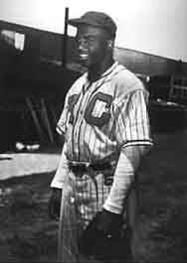
Jackie Robinson
42
Born in Cairo, Georgia, in 1919.
Robinson’s family moved to California after his father deserted the family.
At the University of California in Los Angeles, Robinson starred in football, track, basketball and baseball.
In 1944, Robinson played in the Negro leagues on a team called the Kansas City Monarchs.
Notes:
Jackie Robinson was born in Cairo, Georgia in 1919. His mother’s name was Mallie Robinson and he had four siblings, Willie Mae, Mack, Frank and Edgar. Jackie and his family moved to California in 1920 after his father left the family. Jackie attended UCLA, where he was the first student to letter in 4 varsity sports. He played Football with Kenny Washington, a man who would later become one of the first African American Football players.
After leaving UCLA, Jackie Robinson enlisted in the Army for World War II. Jackie was initially not allowed to attend cadet school. However, after fighting for it, he was allowed in. Jackie never made it to Europe to fight in the war. While training in Fort Hood, Texas, Jackie refused to give up his seat to a white man. He was court-martialed for his actions.
Picture: www.classicphotos.com
<http://www.classicphotos.com/base/Negro_League/bl-433-3.jpg>

Slide 4
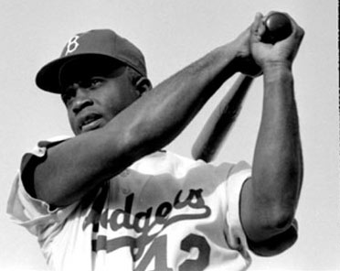
Playing for the Dodgers
Branch Rickey, president and General Manager of the Brooklyn Dodgers, noticed Robinson’s exceptional talent.
In 1946 Branch Rickey signed Jackie Robinson.
Jackie Robinson, at the age of 27, became the first Black Baseball player in Major League history.
Notes:
Branch Rickey had a secret goal of signing the top African American baseball players in the United States to his team. In baseball there was no rule that prevented African Americans from entering the league. However, any attempt by a Black man to enter the league had failed miserably because they were mistreated by league officials and rival players. Branch Rickey told his scouts to search for the top Negro league players in effort to start an all new African American baseball league. However he was secretly looking to sign a star Black Player. Jackie Robinson was the man and in 1946 Jackie was signed to play on a Dodgers Minor League team in Montreal.
Picture (left): Answers.com
<http://www.answers.com/topic/jrobinson-jpg>

Slide 5
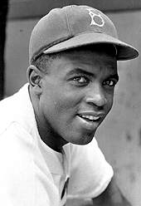
A Strange Choice
Jackie Robinson was not exactly a logical choice to become the first African American ball player.
He was not a prospect. Robinson was already 27 when he entered the league.
He had a somewhat inflammatory temper.
Rickey believed that Robinson’s outspoken mentality would benefit the cause in the long run.
However, Rickey did urge Robinson to maintain a level head in his first few years. Knowing the importance of his actions, Robinson listened.
Notes:
Jackie Robinson was known for his fiery attitude. Many people feared that he would not be able to handle the severe abuse he would be forced to take by racists in the Major Leagues. Many thought the laid back Roy Campanella would be better choice for the job. However, Rickey understood that Jackie’s outspoken style would in the long run benefit the cause. Jackie agreed not to retaliate to any the abuse he would take in his first two years of play and became the first African American ball player to play in the Major Leagues.
Picture: www.espn.com
<http://espn-i.starwave.com/media/classic/2001/0207/photo/c_jrob2_i.jpg>

Slide 6
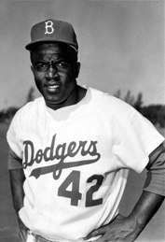
Jackie’s Courage
Jackie Robinson faced virulent racism.
Members of his own team refused to play with him.
Opposing pictures tried to beam his head, while base runners tried to spike him.
He received hate mail and death threats daily.
Fans shouted Racist remarks at him in every ball park.
Hotels and restaurants refused to serve him
Notes:
Robinson took a large amount of abuse in his first seasons as a Dodger. A large group of Dodgers, mostly southerners, led by Dixie Walker threatened to strike if they were forced to play alongside with a Black man. However, Dodger management insisted that the men were welcome to find jobs elsewhere and the threat was rescinded.
Robinson received pestering from both players and fans. Many pitchers would throw pitches at his head while base runners tried to cut him with their cleats. He was verbally attacked by fans, opposing players and even teammates. The most horrific team was the Philadelphia Phillies, lead by manager Ben Chapman, who called out racist slang from the bench and told him to “go back to the jungle.”
Picture: www.veaweteach.com
<http://www.veaweteach.org/images/photos/people/Jackie_Robinson.jpg>

Slide 7
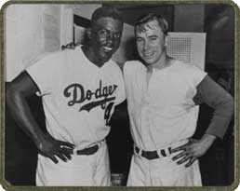
Teammates
One game in Cincinnati the crowd was especially insulting. They were yelling unimaginable insults at Jackie Robinson.
Jackie’s teammate Pee Wee Reese recognized that the crowd was getting to Jackie.
Pee Wee Reese walked across the field and put his arm around Jackie. The two smiled at each other. Their compassion silenced the crowd.
Notes:
Jackie did have some support on the team. A man by the name of Pee Wee Reese from Kentucky was Jackie’s closest friend. The story involving the two men is one of the most inspiring sport stories. The two men were playing for the Dodgers in Cincinnati. The attack on Jackie from the crowd was vicious and Reese decided to walk over and put his arm around Jackie. Pee Wee Reese stared right at the men who were bother Jackie and smiled at Jackie. The crowd was silenced by the action. Jackie remembers, “Pee Wee kind of sensed the sort of hopeless, dead feeling in me and came over and stood beside me for a while. He didn't say a word but he looked over at the chaps who were yelling at me through him and just stared. He was standing by me, I could tell you that. I will never forget it,“
Picture: www.baseball-almanac.com
<http://www.baseball-almanac.com/quotes/reese_robinson.jpg>

Slide 8
Jackie and Civil Rights
Jackie Robinson’s Actions effected the world far beyond Major League Baseball.
His courage and discipline in standing up against racism were a preview of the actions taken by many members of The Civil Rights Movement.
The success of the Jackie Robinson experiment was a testament to fact that integration could exist.
Notes:
Jackie Robinson’s actions were important beyond the scope of Baseball. His actions objectified the mentality of African American Leader’s such as Martin Luther King Jr. His relentless endeavor to desegregate Baseball while refusing retaliate or give in to the racist abuse directed at him was a classic example of the Civil Disobedience that was used during The Civil Rights Movement. Lastly, the success of Jacie Robinson’s attempt gave hope to African Americans everywhere.

Slide 9
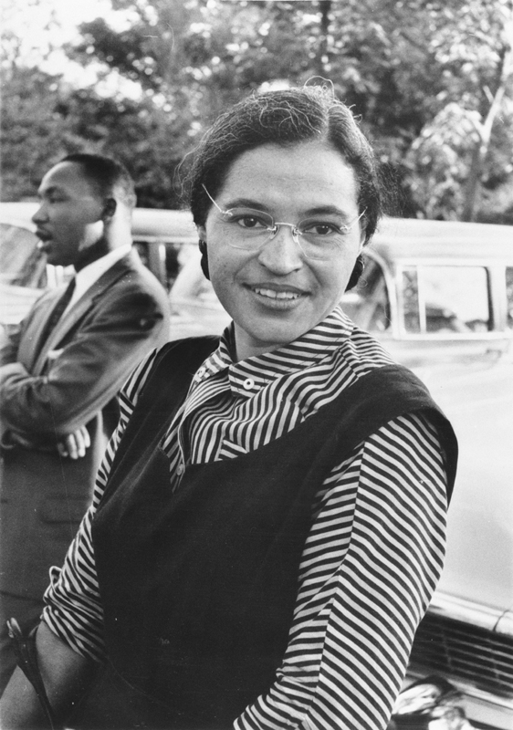
Rosa Parks
Rosa Parks was born on February 4, 1913. She grew up in Pine Level, Alabama, right outside of Montgomery.
In the South, Jim Crowe laws segregated African American’s and whites in almost every aspect of life.
This included a seating policy on buses. White’s sat in the front, Blacks sat in the back.
Buses also drove White students to school. Black students were forced to walk everyday.
Notes:
Rosa Parks was born in Tuskegee Alabama. Her father was a carpenter and her mother was a teacher. As a child she was very small and suffered from constant sickness. When her parents separated, Rosa and her mother moved to Pine Level Alabama, a town right outside of Montgomery.
In the South, Jim Crowe laws separated everyone. While bus and train companies did not provide separate vehicles for Blacks and Whites, there was a seating policy. There was no transportation of Black School children.
When Rosa was a child her school was burned down twice by White Supremacist and the Ku Klux Klan marched down her street.
Picture: www.Answers.com
<http://www.answers.com/topic/rosaparks-jpg>

Slide 10
Events Leading Up To Rosa’s Protest
Parks was an active member of The Civil Rights Movement and joined the Montgomery chapter of NAACP (National Association for the Advancement of Colored People) in 1943.
In 1944 Jackie Robinson refused to give up his bus seat in Texas.
In 1955, Black Activist in Montgomery were building a case around Claudette Colvin, a 15 year old girl who refused to give up her seat on a bus. She was arrested and forcibly removed from the bus.
African Americans made up 75% of the passengers in the Bus system but still had to deal with unfair rules.
Notes:
In 1932 Rosa married Raymond Parks. An African American man who was a member of the NAACP. At the time he was working to help the Scottsboro Boys, Black men who were falsely accused of raping two white women. Later Rosa would become an active member of the NAACP. She worked for awhile in Maxwell Air force Base. At the base segregation was outlawed. Rosa considered this a wake up call because she saw that integration could work at the base.

Slide 11
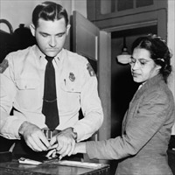
The Arrest
On December 1, 1955 Rosa Parks refused to give up her seat to a White man on a bus.
Parks was arrested and charged with the violation of a segregation law in The Montgomery City Code.
50 African American leaders in the community met to discuss what to do about Rosa’s arrest.
“People always say that I didn't give up my seat because I was tired, but that isn't true. I was not tired physically, or no more tired than I usually was at the end of a working day. I was not old, although some people have an image of me as being old then. I was forty-two. No, the only tired I was, was tired of giving in.” -Rosa Parks Autobiography
Notes:
The Bus company policies in Montgomery were very unfair. The first four rows of every bus were reserved for White people. The back seats were for Blacks, however the bus driver could extend the White section if enough White passengers were on the bus. If a White person came on the bus and there were no seats a Black person had to stand up. If there was no space to stand a Black person would be forced to get off the bus. When White people were sitting in the front rows, Black people had to get on the bus in the front to pay the fare and then walk around to board the bus in the back. Sometimes drivers would leave before the Black person made it to the back entrance. Therefore, they paid the fair but got no ride.
Picture: www.answers.com
<http://www.answers.com/topic/rosaparksarrested-jpeg>

Slide 12
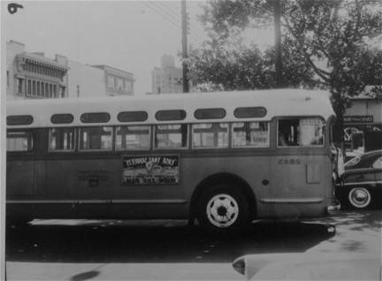
Montgomery Bus Boycott
On December 5, 1955, through the rain, the African Americans in Montgomery began to boycott the busses.
40,000 Black commuters walked to work, some as far as twenty miles.
The boycott lasted 382 days.
The bus companies finances struggled. Until the law that called for segregation on busses was finally lifted.
Notes:
The Montgomery Bus Boycott was important for many reasons. First it was during the Boycott that the most famous Civil Rights leader, Dr. Martin Luther King. Jr., immerged as an important figure. It was also an example of how nonviolent protest could achieve success.
On the day of Rosa’s trial, 35,000 pamphlets were passed out urging African Americans to participate in the boycotting of Montgomery buses. It rained that day but the African American community Boycotted anyway. People would carpooled while others rode in African American operated cabs. Most of the 40,000 commuters walked. After 382 days the law was finally lifted.
Picture: www.kasd.org
<http://www.kasd.org/~civilrights8/bus/bus_files/image004.jpg>

Slide 13
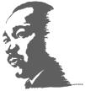
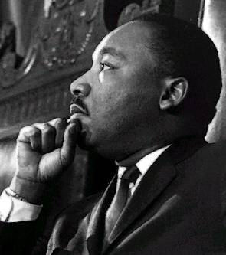
Martin Luther King Jr.
Born in Atlanta, Georgia.
Graduated Morehouse College with a Bachelor of Arts degree in Sociology.
Later, at Boston University, King received a Ph.D. in systematic theology.
In 1953, at the age of 26, King became pastor at the Dexter Avenue Baptist Church in Montgomery Alabama.
His start as a Civil Rights leader came during the Montgomery Bus Boycott.
Notes:
Martin Luther King was born in Atlanta Georgia to Rev. Martin Luther King Sr. and Alberta Williams King. At Morehouse College, King was mentored by Civil Rights leader Benjamin Mays. King later became minister of the Dexter Ave. Baptist Church. King started his campaign for Civil Rights during the Montgomery Bus Boycott. After the movement, King helped found the SCLC (Southern Christian Leadership Conference.)
Picture: www.kycourts.com
<http://www.kycourts.net/AOC/MinorityAffairs/Martin%20Luther%20King,%20Jr.%20--%203.jpg>

Slide 14
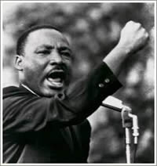
Career As A Leader
In 1955 he became involved in The Montgomery Bus Boycott. The Boycott was the start to his incredible career as the most famous leader of the Civil Rights movement.
He went on to deliver numerous powerful speeches promoting peace and desegregation.
During The March On Washington he delivered one of the most famous speeches of 20th century titled, “I Have A Dream”
Before he was assassinated in 1968, he won the Nobel Peace Prize.
Notes:
King was the most famous leader of the Civil Right’s movement and probably the most instrumental American activist in the 20th century. He was the youngest man to ever win the noble prize and today there is a national holiday that honors his life. He started off his career in defiance of Jim Crowe laws and the vicious Racism African Americans were suffering from across the nation. He saw great accomplishments in his time but most of the things he fought for did not change until after his death. However, those changes would have never occurred if it wasn’t for the monumental help of important leaders such as Martin Luther King Jr.
Picture: www.exodusnews.com
<http://www.exodusnews.com/Photos/MartinLutherKing.jpg>

Slide 15
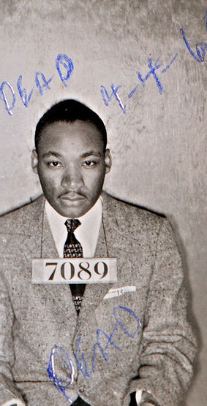
Civil Disobedience
In 1957 King helped found the Southern Christian Leadership Conference (SCLC).
A group that used the authority and power of Black churches to organize non-violent protest to support the Civil Rights Movement.
King believed in the philosophy used by Gandhi in India known as nonviolent civil disobedience. He applied this philosophy to protest organized by the SCLC.
The civil disobedience led to media coverage of the daily inequities suffered by Southern Blacks.
The televised segregation violence led to mass public sympathy. The Civil Rights Movement became the most important political topic during the early 60’s.
Notes:
Civil Disobedience is the refusal to obey civil laws in effort to promote change. Usually involved in changing government policy or legislation, Civil Disobedience is characterized by passive resistance or other nonviolent means. The idea of nonviolent civil disobedience was developed by Gandhi in the struggle for Indian Independence. Martin Luther King Jr. brought the idea of nonviolence to the United States in a strong way. King understood that protesting in non violent ways would ultimately attract the sympathy of people all across the nation. He was right. The televised media coverage of many African American marches and rallies made the Civil Rights Movement important on both a national and global level.
picture.: www.answers.com
<http://commons.wikimedia.org/wiki/Image:Mlkingmug1.jpg>

Slide 16
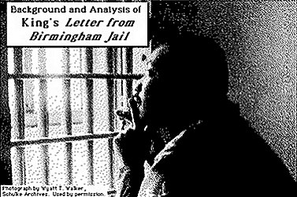
Letter From a Birmingham Jail
King, wrote the letter after being arrested at a peaceful protest in Birmingham, Alabama.
The letter was in response to a letter sent to him by eight Alabama Clergymen called, “A Call For Unity.”
The men recognized that injustices were occurring in Birmingham but believed that the battles for freedom should be fought in the courtroom in not in the streets.
In the letter, “Letter from Birmingham Jail,” King justified civil disobedience by saying that without forceful action, true civil rights would never be achieved. Direct action is justified in the face of unjust laws.
Notes:
The most important aspect of the “Letter From Birmingham Jail” is that it is King’s justification of Civil Disobedience. The letter was written in response to a letter written to king by a group of White clergymen. The clergymen recognized that African Americans were subject to unfair treatment, however they argued that instead of causing public havoc, King should fight the injustices in the court. King responded by stating that no change would possible without the protesting action that King and his followers were taking.
Picture: www.Drmartinlutherkingjr.com
<http://www.drmartinlutherkingjr.com/letterfrombirminghamjail.htm>

Slide 17
Letters From a Birmingham Jail (cont.)
In the letter King justifies civil disobedience in the town of Birmingham.
“I cannot sit idly in Atlanta and not be concerned about what happens in Birmingham. Injustice anywhere is a threat to justice everywhere.”
“There can be no gain saying the fact that racial injustice engulfs this community. Birmingham is probably the most thoroughly segregated city in the United States. Its ugly record of brutality is widely known. Negroes have experienced grossly unjust treatment in the courts.”
“Oppressed people cannot remain oppressed forever. The yearning for freedom eventually manifests itself.”
“We know through painful experience that freedom is never voluntarily given by the oppressor, it must be demanded by the oppressed.
“Wait has almost always meant 'never.‘”
Notes:
The eloquent language of Dr. Martin Luther King Jr. is evident in the letter. He used compassion and sternness together in a wise combination that validates all of his points.

Slide 18
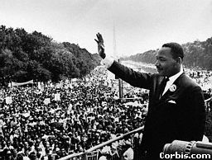
March On Washington
More than 20,000 Black and White Americans celebrated in a joyous day of song, prayer and speeches.
The march was lead by a group of important clergy men, civil rights leaders, and politicians.
Martin Luther King’s “I Have A Dream” speech was the climax of the day.
Notes:
President Kennedy did not want the March On Washington to occur. He thought that it would undermine the Civil Right’s legislation that was being passed in congress. However the march proceeded anyway in one of the most successful events of The Civil Rights Movement. The march was a joyous day of song and prayer. Martin Luther King Jr. stole the crowd with his famous “I Have A Dream” speech.
Picture: www.stanford.edu
<http://www.stanford.edu/group/King/about_king/chronology/graphics/big/630828-049.jpg>

Slide 19
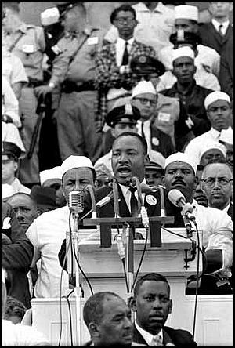
I Have A Dream Speech
In a powerful speech, Martin Luther King Jr. stated eloquently that he desired a world were Black’s and whites to coexist equally.
King’s speech was a rhetoric example oh the Black Baptist sermon style.
The speech used The Bible, The Declaration of Independence, The United States Constitution and The Emancipation Proclamation as sources. He also used an incredible number of symbols in his poetic address.
Notes:
In his most famous speech Dr. Martin Luther King Jr. talked passionately about the future. The speech was the climax of the March On Washington and over 20,000 people heard his words. However, today people across the world are familiar with the timeless phrase, “I Have A Dream.” King didn’t live to see his dreams become a reality. But, because of the incredible work he did during his life, we experience many of his dreams today.
picture: www.americanrhetoric.com
<http://www.americanrhetoric.com/speeches/Ihaveadream.htm>

Slide 20
I Have A Dream Speech (cont.)
The powerful words of Martin Luther King Jr.
“I have a dream that one day this nation will rise up and live out the true meaning of its creed: - 'We hold these truths to be self-evident, that all men are created equal.’”
“I have a dream that one day even the state of Mississippi, a state sweltering with the heat of injustice, sweltering with the heat of oppression, will be transformed into an oasis of freedom and justice.”
“I have a dream that my four little children will one day live in a nation where they will not be judged by the color of their skin but by the content of their character.”
“black men and white men, Jews and Gentiles, Protestants and Catholics - will be able to join hands and sing in the words of the old Negro spiritual: "Free at last! Free at last! Thank God Almighty, we are free at last!"
Notes:
The metaphors and symbolism in the speech is remarkable. The mastery of the English language captivates all who hear King’s voice and sends shivers down their spine. The speech is both prodigious and breathe taking.

Slide 21
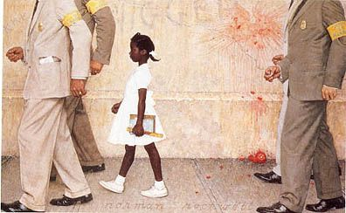
Ruby Bridges
In 1960, at the age of 6, Ruby Bridges became the first black elementary school child to attend a white school.
Due to White opposition of integration, Ruby needed to be escorted to school by federal marshals.
After Ruby entered the school, many of the teachers refused to teach and many of the White students went home.
Ruby went to school everyday.
The Problem We All Live With, By Norman Rockwell
Notes:
At the young age of 6 Ruby Bridges stood up to the most horrific kind of hatred, racism. No one warned Ruby about the mob she would face or told her about the incredible feat that she would reach by entering the school. It is hard to imagine just how much courage it took for Ruby Bridges to wake up every morning and go to school. The painting, The Problem We All Live With, by Norman Rockwell tries to capture the loneliness and fear that Ruby must have felt.
Painting: www.learntoquestion.com
<http://www.learntoquestion.com/resources/database/archives/Norman%20Rockwell,%20the%20Problem%20we%20all%20live%20with.jpg>

Slide 22
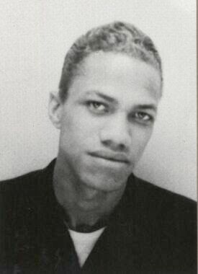
Malcolm X
Born in Omaha Nebraska, Malcolm Little was the son of a Baptist preacher who urged Blacks to stand up for their rights.
His father was killed by White Supremacist in Michigan, in 1931.
After time, Malcolm moved to Harlem where he became involved in gambling, drug dealing and robbery.
Malcolm Was Arrested at the age of 20 for armed robbery. In jail he studied the teaching of the Elijah Muhammad.
Notes:
It is easy to see why Malcolm X would end up developing the hatred towards White people the expressed in his speeches. His father was murdered by White Supremacist when Malcolm was very young. The cops reported that his father committed suicide.
On the street Malcolm was called Detroit red because of his light skin complexion and reddish hair.
Picture: wikipedia.org
<http://en.wikipedia.org/wiki/Image:Detred104.jpg>

Slide 23
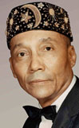
Elijah Muhammad
Elijah Muhammad was the leader of the mostly Black political and religious group The Nation Of Islam.
His teachings, often perceived as racist, preached complete separation from Whites in society.
He often expressed the idea the Blacks were the first people to rule the world and that the Whites tricked them out of power and oppressed them.
Young Malcolm X developed his adept speaking skills and political ideas under the direction of Elijah Muhammad.
Notes:
When Malcolm X was in jail he earned the nickname Satan because he constantly cursed god and religion. However, he received mail from the Nation Of Islam. He instantly was drawn to the teachings of Elijah Muhammad because of his stance on White people. Elijah Muhammad believed that all Caucasians were evil.
Picture: www.answers.com
<http://www.answers.com/topic/hon-elijah-muhammad-jpg>

Slide 24
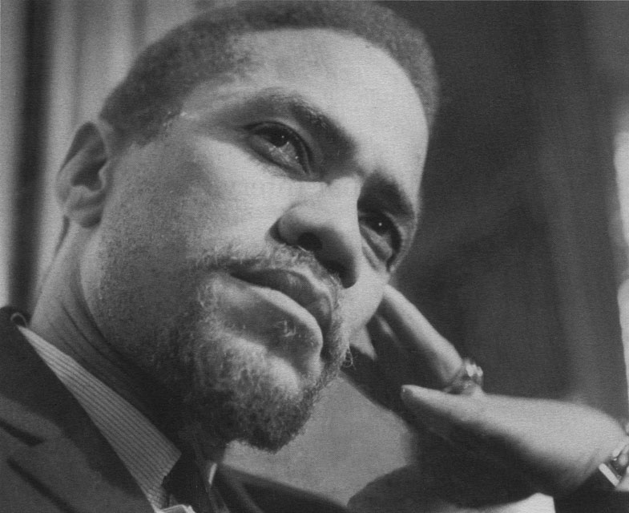
Nation Of Islam
The Nation Of Islam (NOI) was an activist group that believed that most African slaves were originally Muslim.
The NOI urged African Americans to reconvert to Islam in effort to restore the heritage that was stolen from them.
The NOI wanted to create a second Black nation within the United States.
The “X” in Malcolm’s name symbolizes the rejection of his slave name.
Notes:
In jail Malcolm X became and avid reader of history and philosophy. In his reading he discovered a lot of information justifying the teachings of Elijah Muhammad and the Nation Of Islam. Malcolm’s first contact to Elijah Muhammad came through a letter. Eventually Malcolm wrote a leader to Elijah everyday.
Picture:www2.cddc.vt.edu
<http://www2.cddc.vt.edu/marxists/reference/archive/malcolm-x/1965/02/16.jpg>

Slide 25
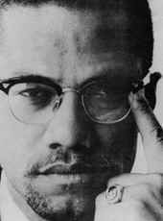
Malcolm X: The Activist
Malcolm X made constant accusations of racism and demanded violent actions of self defense.
He constantly retold the injustices his people suffered in the past.
Malcolm X gathered wide spread admiration from African American’s and wide spread fear from Whites. However White college students could not ignore the harsh realities of his preaching's.
Notes:
Some of Malcolm X’s theories are extremely controversial, however what can not be denied is that he had an incredible influence on the world as a leader. His retelling of of the injustices suffered by his people rallied up African American support behind him. The violence he urged in response to the injustices instilled fear in whites.
Picture: www.blackagenda.com
<http://www.blackagenda.com/images/cyber/malcolm-01.jpg>

Slide 26
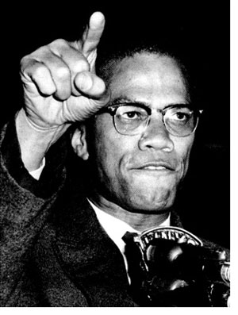
Malcolm X Speaks, 1965
“Be peaceful, be courteous, obey the law, respect everyone; but if someone puts his hand on you, send him to the cemetery.”
“Nobody can give you freedom. Nobody can give you equality or justice or anything. If you're a man, you take it.”
“You can't separate peace from freedom because no one can be at peace unless he has his freedom.”
Notes:
Through the quotes it is clear that Malcolm held some controversial views. However, it is impossible to ignore the pragmatism behind some of his most contentious arguments. There is 20th century speaker that emphasized the amount of power in their words than Malcolm X did.
Picture: www.selvesandothers.org
<http://www.selvesandothers.org/IMG/jpg/malcolmX_300.jpg>

Slide 27
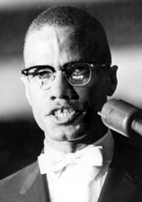
Tension In The Nation Of Islam
By the start of the 60’s Tension was growing in The Nation of Islam.
Malcolm X was exposed to rumors that Elijah Muhammad had indulged in extramarital affairs.
Adultery is shunned in the Muslim doctrine.
Malcolm Believed that Elijah Muhammad was jealous of his increasing popularity.
The Nation of Islam blamed Malcolm X for his controversial remarks regarding John F. Kennedy Jr.
Notes:
Although Malcolm revered Elijah Muhammad in jail, but the early 60’s the relationship developed a significant amount of turbulence. Malcolm heard rumors that Elijah Muhammad was performing adultery and had fathered a large number of illegitimate children. In Islam it is a great sin to perform adultery. Malcolm would later verify the charges of adultery by talking to some of the woman who took place in the action.
Picture: www.infoplease.com
<http://img.infoplease.com/images/malcolmx.gif>

Slide 28
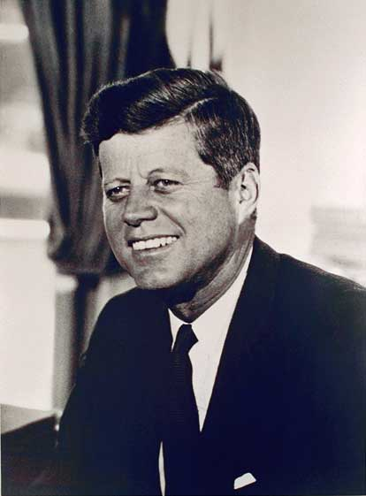
The JFK Controversy
After the assassination of John F. Kennedy, Malcolm X made a speech.
Malcolm claimed that the violence Kennedy failed to prevent ended up to come back and claim his life.
He stated that assassination was an example of “the chickens coming home to roost"
He later stated, "Chickens coming home to roost never made me sad. It only made me glad."
This comment lead to widespread public dismay.
Notes:
Malcolm X’s comments regarding the assassination of president John F. Kennedy Jr. were of his most controversial. He basically stated that Kennedy had got what he deserved and that he was not mournful about the death. His comments led to public outcry.
Picture: www.historyplace.com
<http://www.historyplace.com/specials/portraits/presidents/port-jfk.jpg>

Slide 29
Pilgrimage to Mecca
In 1964, during a pilgrimage to Mecca, Malcolm discovered that orthodox Muslims preach equality among races.
Malcolm’s new knowledge and growing distrust with the NOI, caused him to desert his argument that all Whites are the devil.
Malcolm X never abandoned his theory that Racism had destroyed the nation and that only Blacks could free themselves.
In 1965 Malcolm X was assassinated by a Black Muslim at a New York City rally.
Notes:
When Malcolm X took his Hajj, or Pilgrimage to Mecca, he discovered the true structure of Islam. The religion actually preached equality among races and peace. This lead Malcolm to give up his theory that all Caucasians were the devil and part from the Nation Of Islam. The trip had a profound effect on his later life because it changed many of his radical views. It was his changing views and parting with the NOI that ultimately resulted in his death. Many people believe that the NOI killed him, however there as been no proof that they were linked to the murder.

Slide 30
Malcolm X Quotes (On King)
He got the peace prize, we got the problem.... If I'm following a general, and he's leading me into a battle, and the enemy tends to give him rewards, or awards, I get suspicious of him. Especially if he gets a peace award before the war is over.
I'll say nothing against him. At one time the whites in the United States called him a racialist, and extremist, and a Communist. Then the Black Muslims came along and the whites thanked the Lord for Martin Luther King.
I want Dr. King to know that I didn't come to Selma to make his job difficult. I really did come thinking I could make it easier. If the white people realize what the alternative is, perhaps they will be more willing to hear Dr. King.
Dr. King wants the same thing I want -- freedom!
Notes:
Malcolm X and Dr. Martin Luther King Jr. did have different views on the means, but in the long run they both had similar aspirations. They both wanted Racial equality in the United States and for African American’s to rise up together and create their own foundation for success

Slide 31
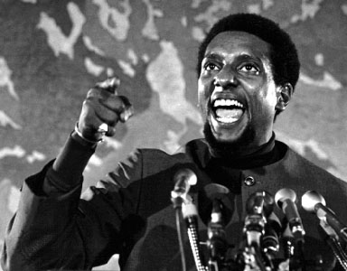
Black Power
Black Power is a term that emphasizes racial pride and the desire for African Americans to achieve equality.
The term promotes the creation of Black political and social institutions.
The term was popularized by Stokely Carmichael during The Civil Rights Movement.
Many SNCC (Student Nonviolent Coordinating Committee) members were becoming critical of leaders that articulated non-violent responses to racism.
Stokely Carmichael
Notes:
Black Power means Black nationalism. It is celebrating being Black as a unique and positive quality. A quality that all Blacks alike should group together and form their own position of power.
Picture: www.marxists.org
<http://www.marxists.org/history/usa/workers/black-panthers/pics/carmichael.jpg>

Slide 32
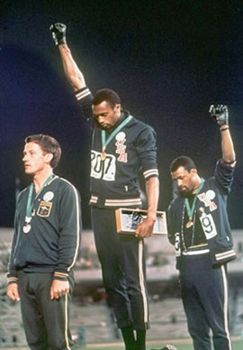
Tommie Smith and John Carlos
Tommie Smith and John Carlos give the Black Power salute at the 1968 Summer Olympics.
The two men were suspended by the United States team and banned from Olympic village.
The action is considered a milestone of The Civil Rights Movement.
Notes:
Tommie Smith and John Carlos’s nod to Black power is the most poignant image of the Black power movement. The two men stood in front of the world and raised their black glove covered fist.
Picture: www.Answers.com
<http://www.answers.com/topic/carlos-smith-jpg>

Slide 33
Black Panther Party
U.S. African American Militant group.
Founded in 1966 in Oakland.
Led by Huey P. Newton and Bobby Seale.
Believed violent revolution was the only way to receive freedom.
Urged African Americans to arm themselves.
Notes:
Of the Black militant groups, the Black Panther Party was probably the most influential. The Black Panther Party spurred from the anger that fueled the Black power movement. For five years the party brought the fierce cries for equality to the largest cities in the United States.
The Blank Panthers included African Americans who could not stand the slow pace of the Civil Rights Movement. Panthers wanted changes immediately.
Picture: www.answers.com

Slide 34
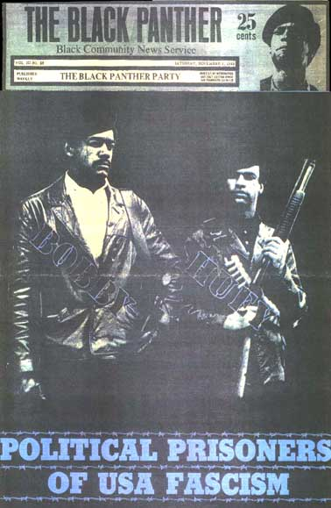
The Violent Panthers
In the late 60’s party leaders got involved in violent confrontations with the police.
The results was death on both sides.
Huey Newton was tried in 1967 for killing a police officer.
Black Panther activist Bobby Seale, was a member of the Chicago Eight.
A group of eight people who disrupted the 1968 Democratic convention.
Notes:
Members of the Black Panther Party were always seen on TV. They were dressed in black leather coats. They had a shot gun in one hand and a law book in the other. The Black Panthers were ready to confront police officers and fight crime in court.

Slide 35
Conclusion
During The American Civil Rights Movement many different and unique leaders and groups came to power.
Some preached violence, some preached peace, some preached protest and some preached resilience.
However, every leader had one thing in common. They all wanted freedom and they all wanted equality for their race.
Today we celebrate the leaders struggles because it was there work that got us to the point we are at today.
Now, not everything is completely equal. But it is clear that we have come a long way since Martin Luther King Jr. marched in Washington and cried out, “I Have A Dream”

Slide 36
AMAZING GRACE
Amazing Grace! How sweet the sound That saved a wretch like me I once was lost but now am found, Was blind but now I see. 'Twas Grace that taught my heart to fear And Grace my fears relieved How precious did that grace appear The hour I first believed. Through many dangers, toils and snares I have already come 'Tis Grace has brought me safe thus far And Grace will lead me home. The Lord has promised good to me His word my hope secures; He will my shield and portion be, As long as life endures. Yet, when this flesh and heart shall fail, And mortal life shall cease, I shall possess within the veil, A life of joy and peace. When we've been there ten thousand years Bright shining as the sun, We've no less days to sing God's praise Than when we've first begun

Slide 37
The End

